Slide 1
Untitled: Four Etchings [C], 1992
Glenn Ligon
Notes:
Painter, photographer, and printmaker Glenn Ligon's provocative artwork mines the history of African-American culture, from slave narratives to the "Million Man March" on Washington, D.C.
‹#›

Slide 2
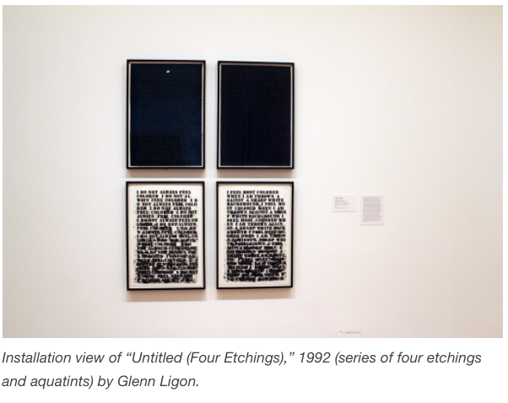

Slide 3
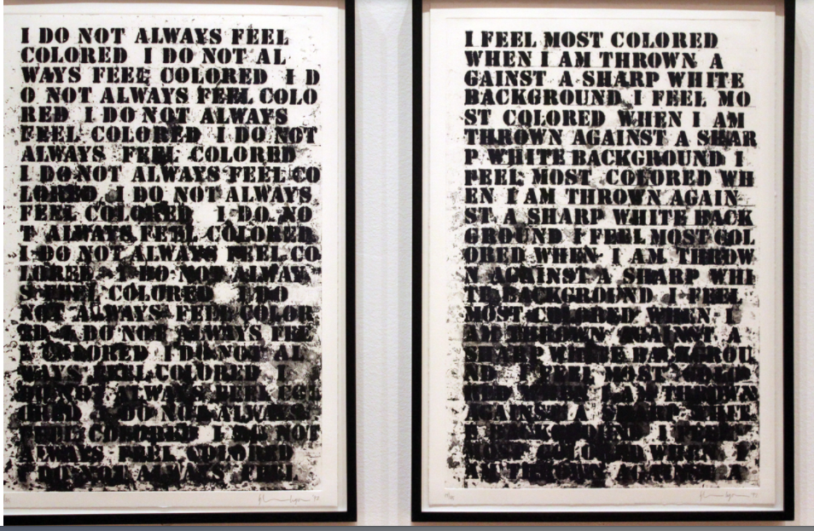

Slide 4
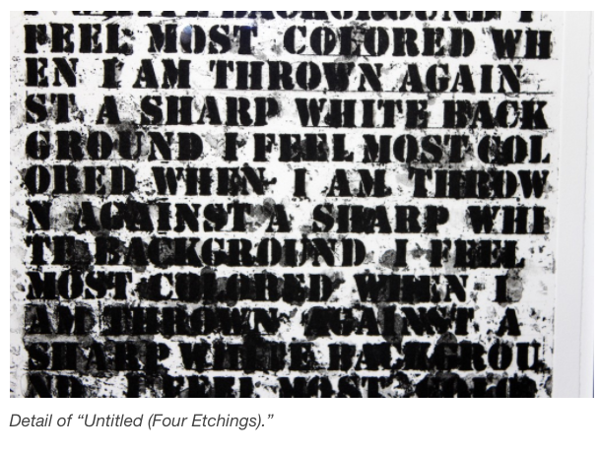

Slide 5
Read the text used by Glenn Ligon in his work, Untitled: Four Etchings [C], 1992 Notice what you notice.
Notes:
In this suite of untitled etchings, Ligon addresses lingering racism in America by invoking the autobiographical writings of renowned black authors. The prints with black texts printed on white paper feature excerpts from the 1928 essay "How It Feels to Be Colored Me" by Zora Neale Hurston. Ligon explains: "The prints play with the notion of becoming 'colored' and how that 'becoming' obscures meaning and also created this beautiful, abstract thing.”
Glenn Ligon borrowed the words repeated across Untitled (I Do Not Always Feel Colored) from a 1928 essay by Zora Neale Hurston, “How It Feels to Be Colored Me,” which considers the idea that skin color is a social construction. In his painting, Ligon applied the phrase “I do not always feel colored” to the support over and over by rubbing oil stick through a plastic stencil onto the gessoed surface of a door. Ligon’s technique allowed for a remarkably subtle range of optical and expressive effects, depending on which black oil stick he used, how many times he went over a letter, and how often he cleaned the back of his template. As Ligon worked his way down the support, the text became progressively smudged and illegible because the greasy oil stick left a residue that adhered to the stencil. This transition from block-letter clarity to illegibility is a meaningful effect, playing on the idea of text as something that is shifting and malleable. “It makes the words cast shadows, bleed into one another, [so that] their meanings seem less fixed,” remarked Ligon about his technique. “The smearing also creates a visual interaction with the gesso ground, a metaphor for the interaction between blacks and whites in the construction of racial identity.” Object Label
Glenn Ligon borrowed the words repeated across Untitled (I Do Not Always Feel Colored) from a 1928 essay by Zora Neale Hurston, “How It Feels to Be Colored Me,” which considers the idea that skin color is a social construction. In his painting, Ligon applied the phrase “I do not always feel colored” to the support over and over by rubbing oil stick through a plastic stencil onto the gessoed surface of a door. Ligon’s technique allowed for a remarkably subtle range of optical and expressive effects, depending on which black oil stick he used, how many times he went over a letter, and how often he cleaned the back of his template. As Ligon worked his way down the support, the text became progressively smudged and illegible because the greasy oil stick left a residue that adhered to the stencil. This transition from block-letter clarity to illegibility is a meaningful effect, playing on the idea of text as something that is shifting and malleable. “It makes the words cast shadows, bleed into one another, [so that] their meanings seem less fixed,” remarked Ligon about his technique. “The smearing also creates a visual interaction with the gesso ground, a metaphor for the interaction between blacks and whites in the construction of racial identity.”
‹#›

Slide 6
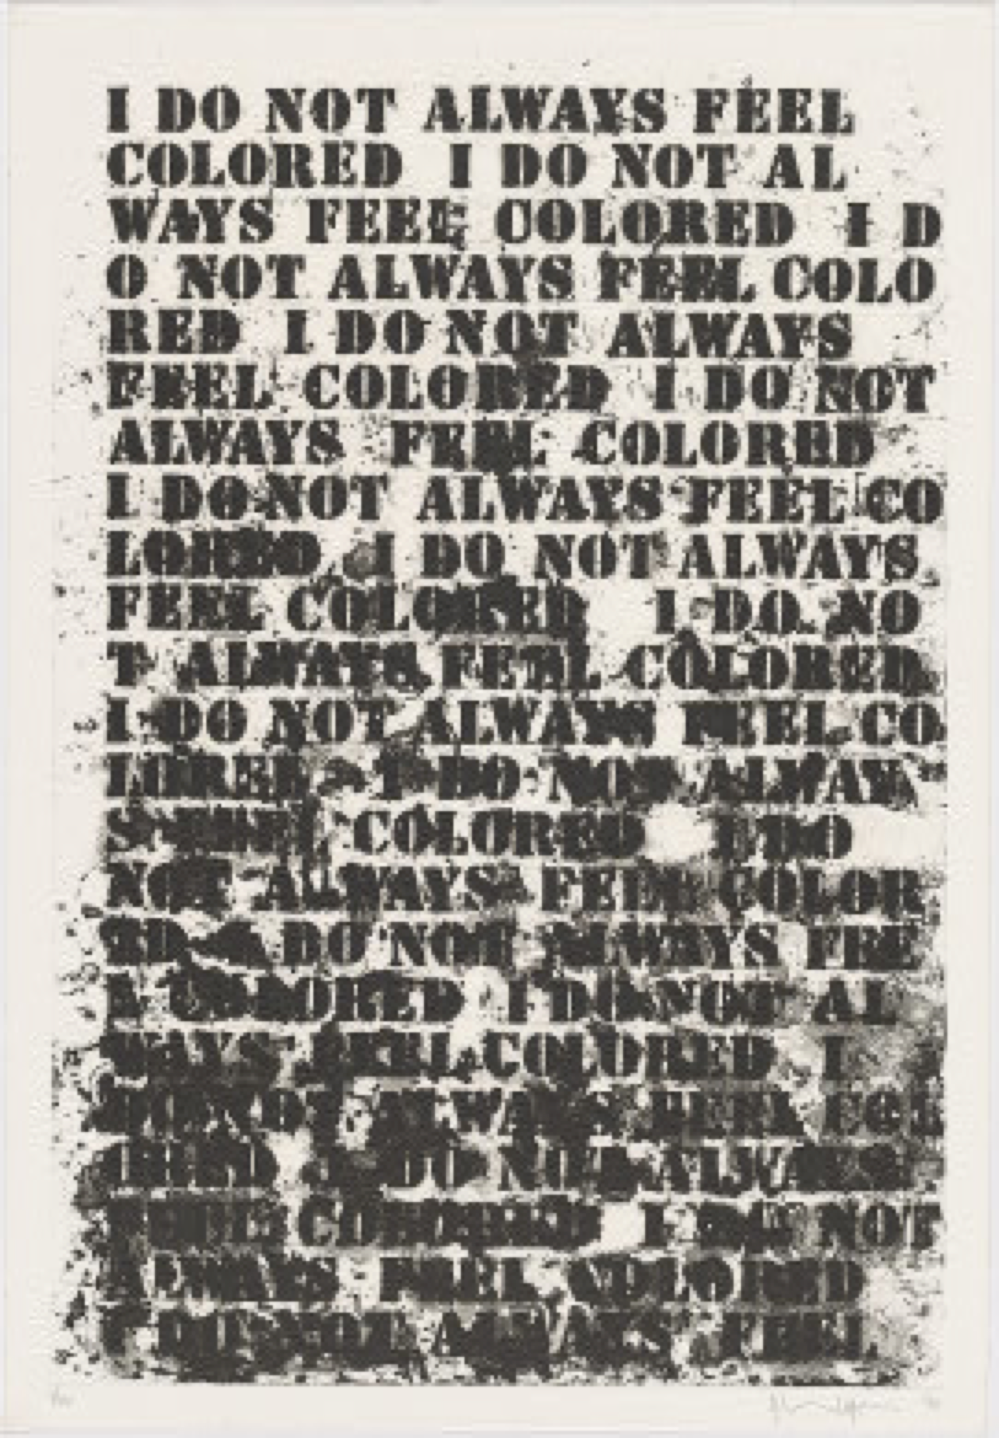
“I do not always feel colored”
from a 1928 essay by Zora Neale Hurston, “How It Feels to Be Colored Me”
Glenn Ligon. Untitled: Four Etchings [A], 1992.
Softground etching, aquatint, spitbite, and sugarlift aquatint in black on Rives BFK paper: 63.8 x 44.1 cm (25 1/8 x 17 3/8 in.)

Slide 7
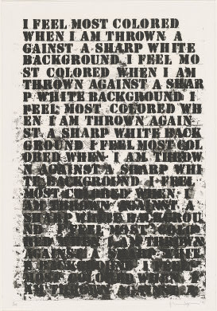
“I feel most colored when I am thrown against a sharp white background”
from a 1928 essay by Zora Neale Hurston, “How It Feels to Be Colored Me”
Glenn Ligon. Untitled: Four Etchings [B], 1992

Slide 8
Glenn Ligon. Untitled: Four Etchings [C], 1992
(Image is black text on black paper.)
Notes:
The pair with black texts printed on black paper feature texts from Ralph Ellison's 1952 novel Invisible Man, which describes blacks in America as ghosts, present and real, but because of racism, remaining unseen. Together, the pairs of prints symbolically illustrate the continued separation between the races.
‹#›

Slide 9
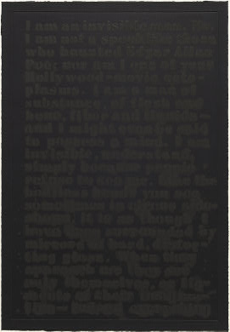
The text is taken from Ralph Ellison’s 1952 novel nvisible Man and reads
as follows:
I am an invisible man. No, I am not a spook like those who haunted Edgar Allan Poe; nor am I one of your Hollywood-movie ectoplasms. I am a man of substance, of flesh and bone, fiber and liquids—and I might even be said to possess a mind. I am invisible, understand, simply because people refuse to see me. Like the bodiless heads you see sometimes in circus side-shows, it is as though I have been surrounded by mirrors of hard, distorting glass. When they approach me they see only themselves, or figments of their imagination…

Slide 10
Glenn Ligon. Untitled: Four Etchings [C], 1992
The text is taken from Ralph Ellison’s 1952 novel
Invisible Man and reads as follows:
I am an invisible man. No, I am not a spook like those who haunted Edgar Allan Poe; nor am I one of your Hollywood-movie ectoplasms. I am a man of substance, of flesh and bone, fiber and liquids—and I might even be said to possess a mind. I am invisible, understand, simply because people refuse to see me. Like the bodiless heads you see sometimes in circus side-shows, it is as though I have been surrounded by mirrors of hard, distorting glass. When they approach me they see only themselves, or figments of their imagination—indeed, anything except me.
Notes:
https://collections.artsmia.org/art/43462/untitled-four-etchings-c-glenn-ligon
Glenn Ligon. Untitled: Four Etchings [D], 1992 (Image is black text on black paper.)
‹#›

