Slide 1
Discussion Questions

Slide 2
Discuss:
What incongruities did you notice?
What similarities and differences do you notice in the descriptions?
What do you think Ligon’s intentions are in creating these pieces?
How is the artist using language to express his individuality?

Slide 3
What do you think are Ligon’s intentions in emulating the Runaway Slave Advertisement format?

Slide 4
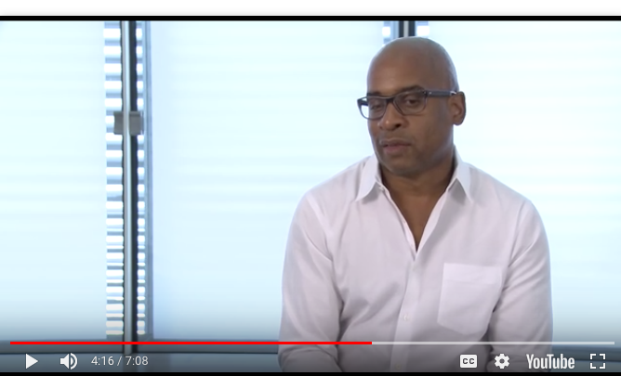
Glenn Ligon’s installation, To Disembark
https://alchetron.com/Glenn-Ligon-718276-W
(see 2:00 – 4:16)

Slide 5
Final Thoughts
How does Ligon use language (written and visual, in the form of images and format) to convey his identity in relation to American society in these lithographs? Using your notes and the posters, come up with at least two ideas.

Slide 6
Your Turn
Pair up with someone who knows you relatively well. Decide who is Person A and Person B.
In two minutes, Person A should find out as much as you can about Person B, including one little known fact.
Now switch. Person B interviews Person A.

Slide 7
Each of you should now write a 4-6 sentence description of the other person, as if the person were missing and you were describing that missing person.
When you are finished writing, the description should end up in the possession of the person you just described.

Slide 8
Now pair up with someone you don’t know very well or at all and repeat.
Finally, pair up with anyone you choose.

Slide 9
Curated Identity Project

Slide 10
Insert Other Ligon PP here

Slide 11
Reflect
Has someone ever used language (visual, written, or verbal) to create your identity rather than allowing you to create it yourself?

